Slide 1


Email Security
Lesson One

Slide 2
Email security

Slide 3
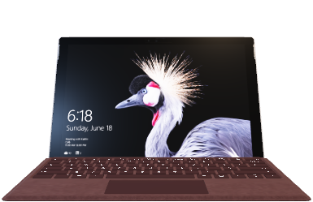
Email security lesson one

