Slide 1
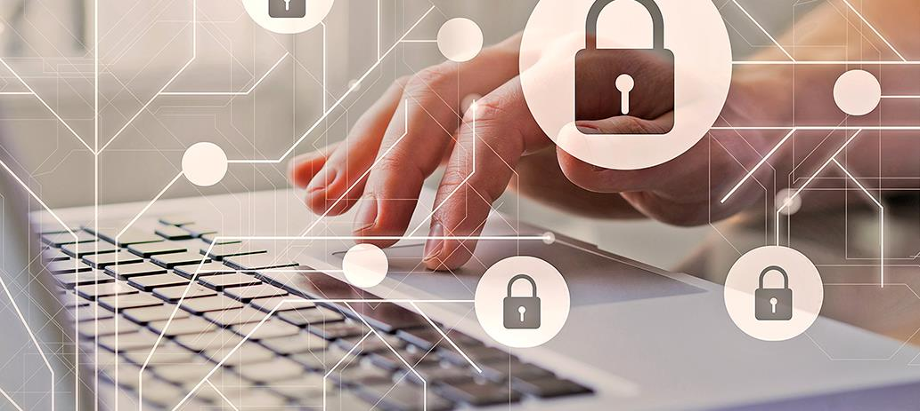
Modern Cyber Attacks

Slide 2
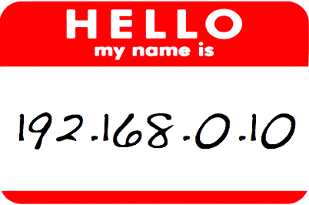
What do you look like to a bad guy?
66.233.160.64

Slide 3
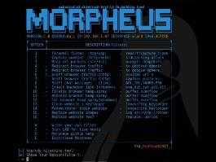
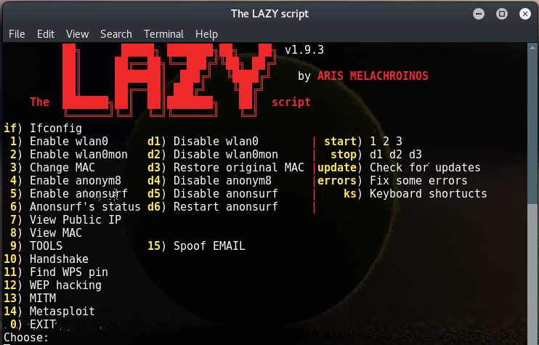
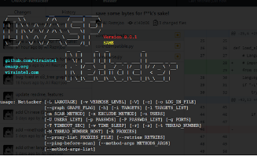
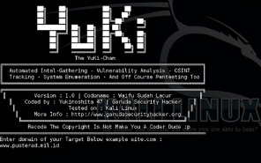
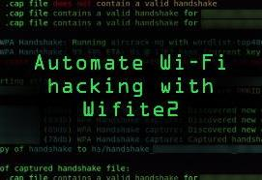
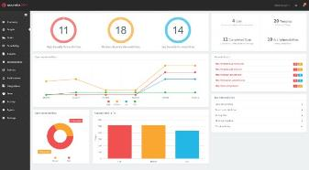
Attacks today are AUTOMATED
It’s not some dude sitting at his hacker desk all day typing out ping commands to IP addresses via the command prompt manually…

Slide 4
Most Exploited Vulnerabilities
CVE-2020-1472 – MS Netlogon Remote protocol (Zerologon)
CVE-2017-0143 - EternalBlue (WannaCry)
CVE-2019-0708 - Remote Desktop Services RCE (BlueKeep)
CVE-2018-8174 - Windows VBScript Engine RCE (Double Kill)
CVE-2018-4878 – Adobe Flash 0-Day (CandGrab)
CVE-2017-11882 – Microsoft Office RCE (Microsoft Office Memory Corruption Vulnerability – 17 years old!)​
CVE-2012-0158 – MS Office ActiveX RCE

Slide 5
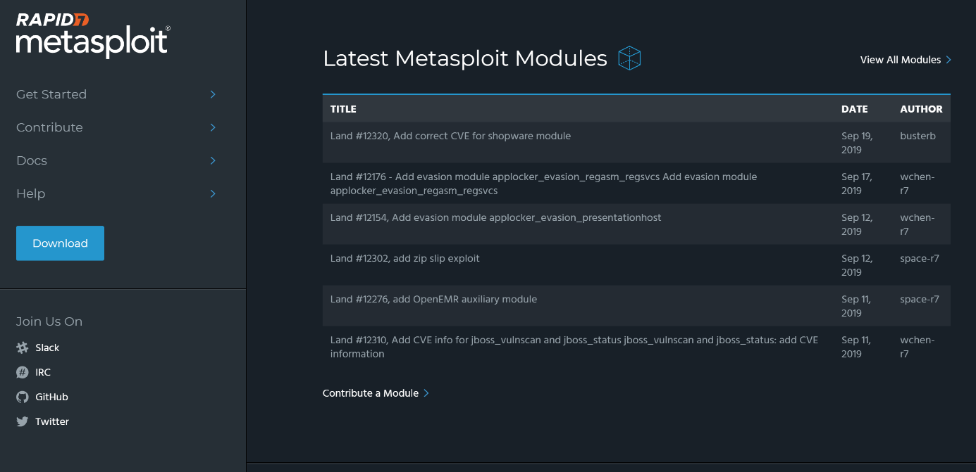
Automated, remember?

Slide 6
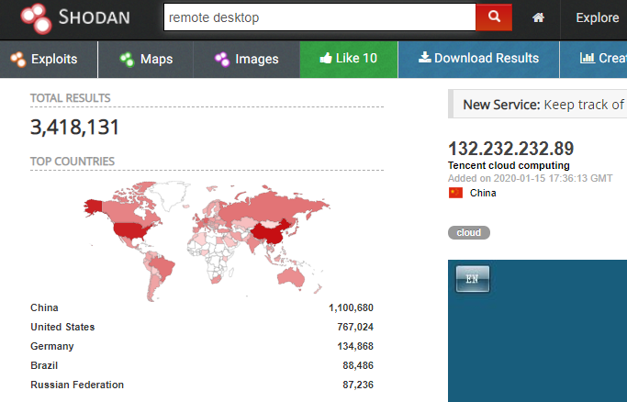
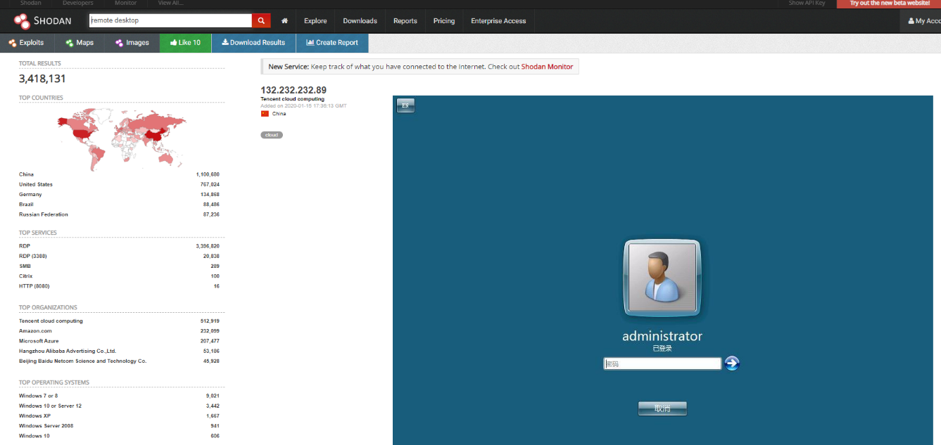
Shodan.io

Slide 7
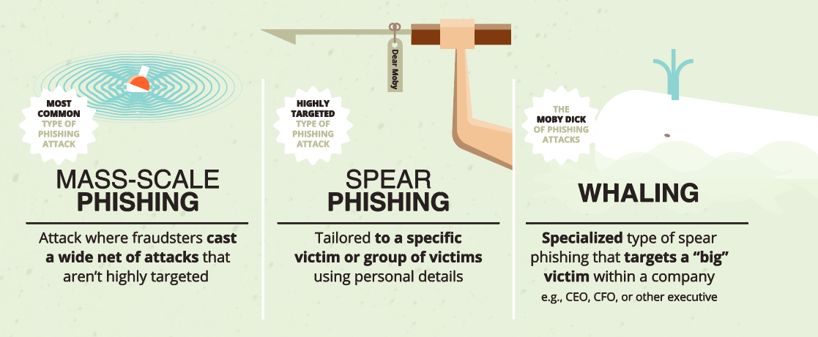
Email Phishing

Slide 8
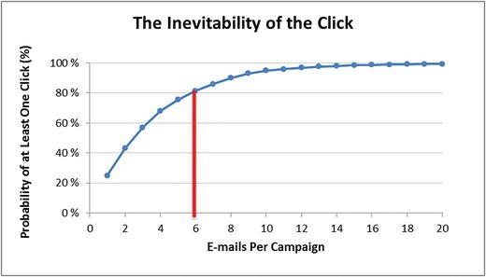
Phishing Statistics
Verizon DBIR 2020: Phishing is the biggest cyber threat for SMBs, accounting for 30% of SMB breaches
KnowBe4: 37.9% of Untrained Users Fail Phishing Tests
84% of SMBs are targeted by Phishing attacks
A new Phishing site launches every 20 seconds
74% of all Phishing websites use HTTPS
94% of Malware is delivered via email

Slide 9
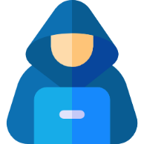
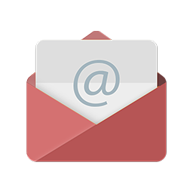


Phishing is an INSIDER Threat
User Action
Malicious
www.website.com
Malicious
Goals:
Money
Data
Volume

Slide 10
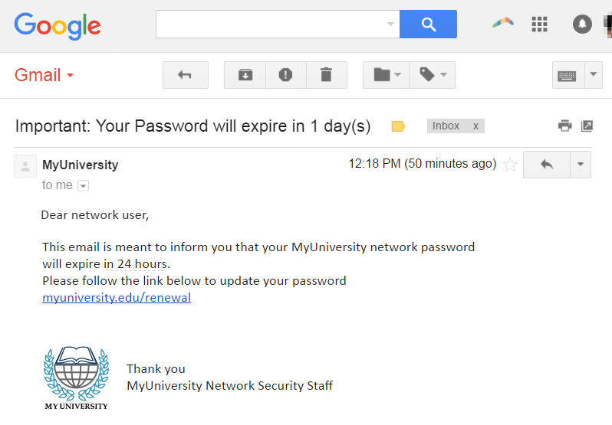
Examples of Phishing

Slide 11
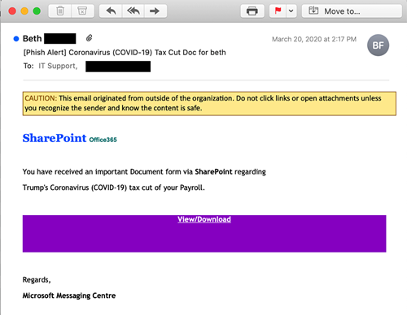
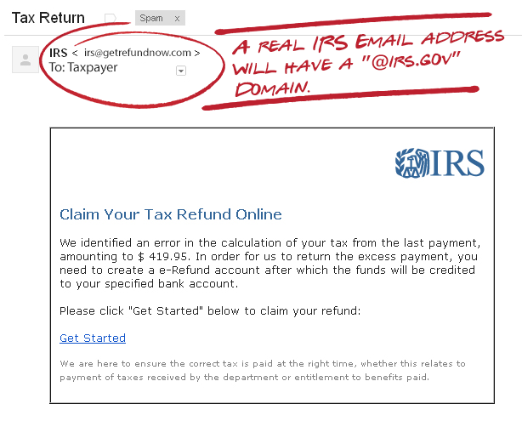
Examples of Phishing

Slide 12

Social Engineering Best Practices​
USE YOUR SECURITY SPIDER SENSE!​
ALWAYS validate requests for information if you’re not 100000% sure​
  Call a number YOU know
  Google it…
ALWAYS ASK QUESTIONS!​
  Is this who I think it is FOR SURE?​
  Did someone mention this to me personally, ​or was it discussed at a staff meeting?​
  Is this the FIRST I’m hearing about this?​

Slide 13

Ransomware Rising
MAJOR increase in ransomware attacks in 2019 – 118% year-over-year
Insurance companies paying the ransom = higher ransoms; upwards of MILLIONS of dollars
  Average Ransom Payout - $178,254 as of Q2 2020 (up 60% from Q1 2020)
Healthcare, government, transportation, and MSPs all being actively targeted
Hackers often getting in via vulnerable RDP and say undetected for months before launching a carefully crafted attack

Slide 14
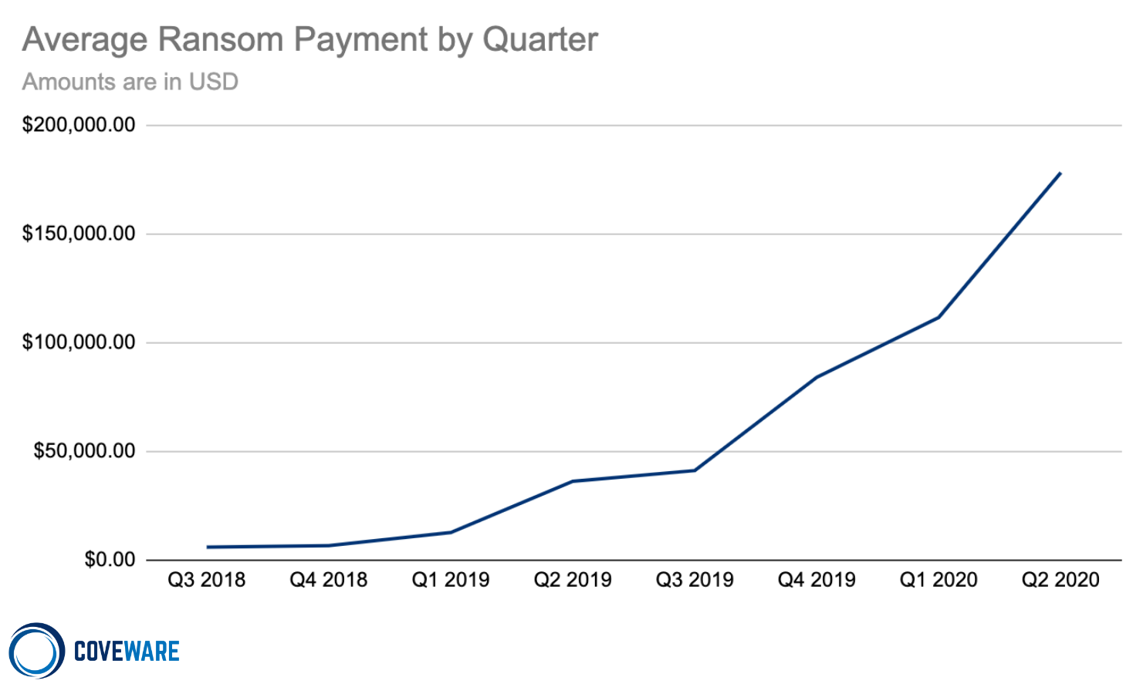
Ransomware Rising

Slide 15
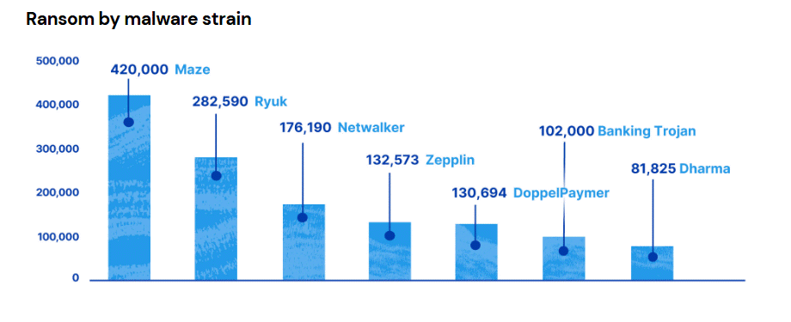
Ransomware Trends

Slide 16
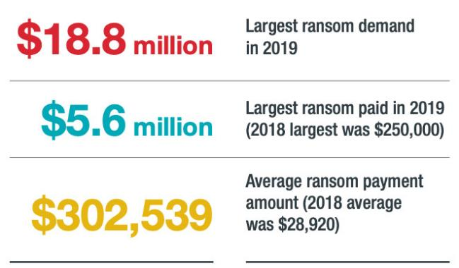
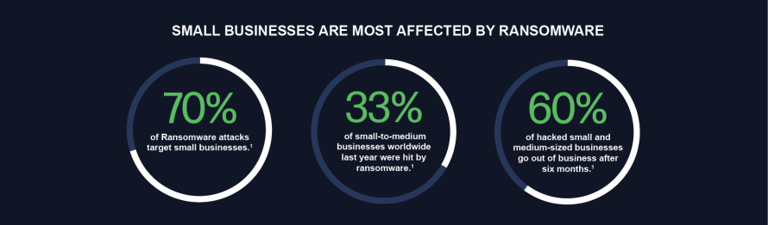
Ransomware Trends
Average Company size of ransomware victims:
  625 employees
MEDIAN Company size of ransomware victims:
  62 employees

Slide 17
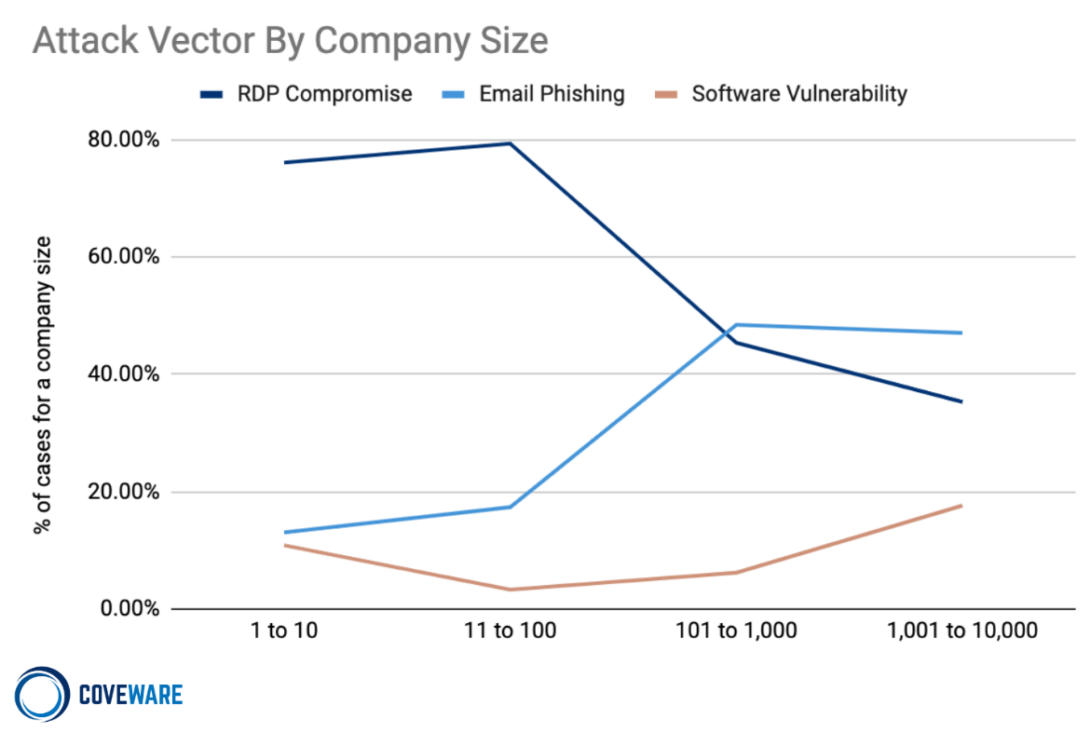
Ransomware Trends

Slide 18

Big Game Hunting
MO of ATP Groups
The bigger the target, the more value to extract

Slide 19
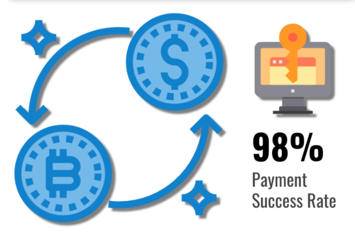
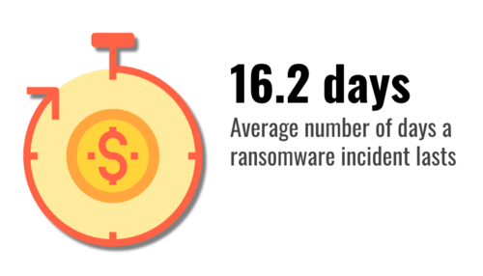
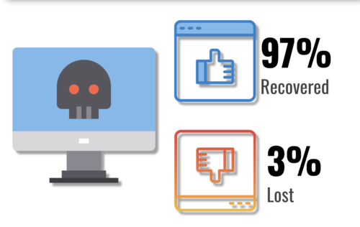
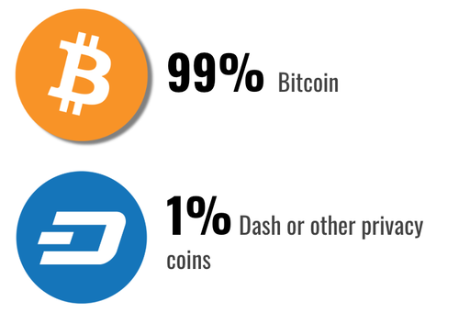
Tactical Ransomware Stats

Slide 20
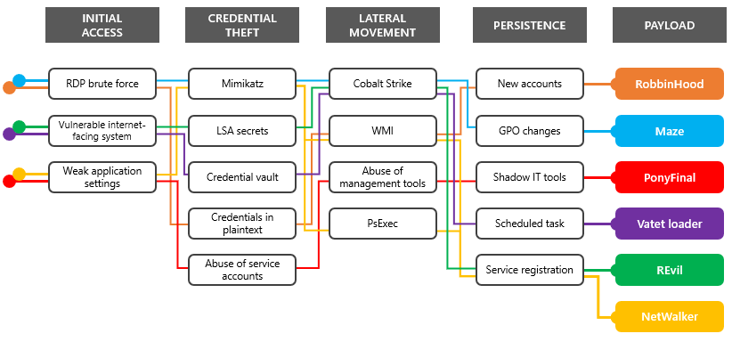
Ransomware Tactics
Top Ransomware Vulnerabilities:
RDP or Virtual Desktop endpoints without MFA
Citrix ADC systems affected by CVE-2019-19781
Pulse Secure VPN systems affected by CVE-2019-11510
Microsoft SharePoint servers affected by CVE-2019-0604
Microsoft Exchange servers affected by CVE-2020-0688
Zoho ManageEngine systems affected by CVE-2020-10189
https://www.microsoft.com/security/blog/2020/04/28/ransomware-groups-continue-to-target-healthcare-critical-services-heres-how-to-reduce-risk/

Slide 21
Ransomware = Data Breach
Today’s ransomware is typically deployed on the way “out” by hackers to cover their tracks
Full Network Compromise
  Average of 40 days in network before ransomware is executed
Super destructive
Ransom is NOT the main objective
  Exfiltration of financial data and anything they can monetize
  Forensics on a ransomed network is spotty at best
    You can’t tell the whole story or what happened, how, and when

Slide 22

Ransomware Controls
Weapons-Grade Data Backups
Religious Patch Management
Plan to Fail Well (Incident Response Plan)
  Know who to call!
Training and Testing Your People
Don’t Open that Email Link/Attachment

Slide 23
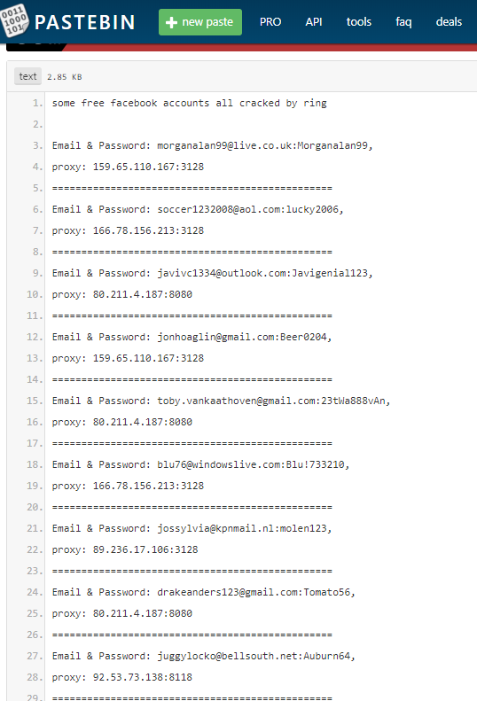
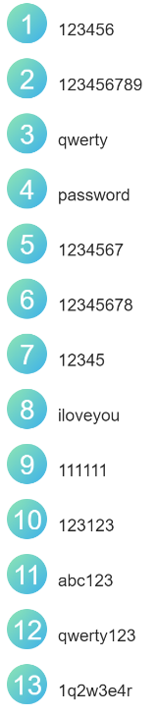
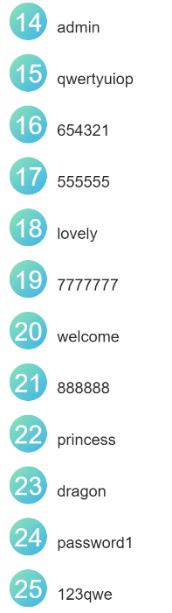
Password Reuse
Top 25 worst passwords of 2019

Slide 24
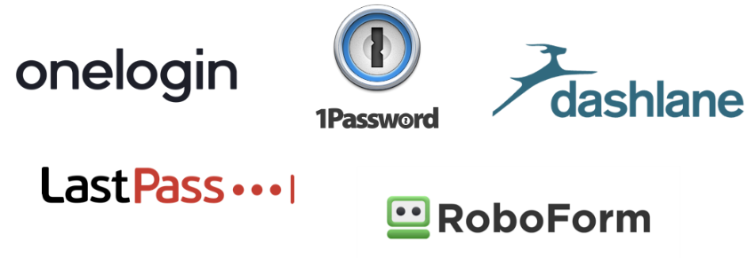
Modern Password Rules
Longer = better (12 chars – user; 16 chars – admin)
Don’t reuse passwords
Still a good idea to change your password occasionally
Use a Password Manager
  LastPass
  Dashlane
  Keeper
  KeePass
  1Password
Monitor Your Accounts Online

Slide 25
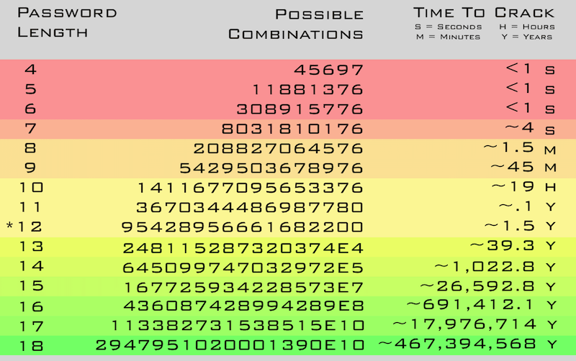
Passwords: All About Length

Slide 26
Password Cracking
20 hours, $18, and 11 Million Passwords Cracked:
  https://hackernoon.com/20-hours-18-and-11-million-passwords-cracked-c4513f61fdb1
High-Power Cloud Hash Cracking with NPK (Coalfire – average cost $4/hour):
  https://www.coalfire.com/The-Coalfire-Blog/March-2019/High-Power-Hash-Cracking-with-NPK
NIST SP 800-63-3 (July 2017 – updated March 2020) – includes password guidelines:
  https://pages.nist.gov/800-63-3/sp800-63b.html

Slide 27
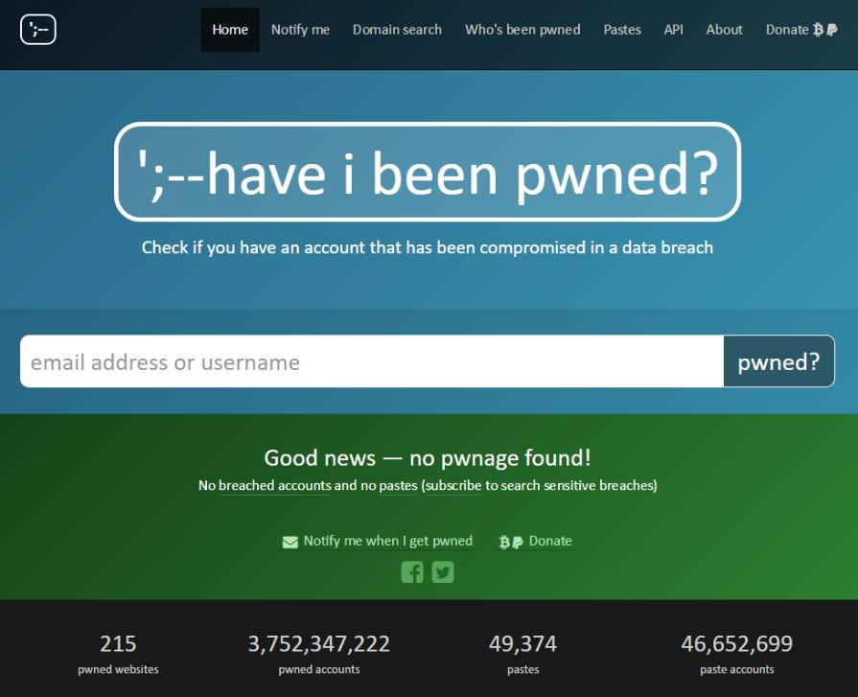
Have I been Pwned?
https://haveibeenpwned.com/

Slide 28
COVID-19 Cyber Threats
Google: 18+ Million COVID-19 emails in just the last week, in addition to 240M daily COVI-19 spam messages
Phishing up 667% right now
FBI IC3: 4x complaints per day (1K before COVID-19, now 3k-4k per day)
148% spike in ransomware attacks due to COVID-19
30%-40% increase in attacker interest relating to RDP (as measured by Shodan)
26% increase in e-comm web skimming in March
Healthcare, Financial Services, Medical Suppliers and Manufacturing, Government and Media Outlets all seeing a large increase in cyber threats

Slide 29
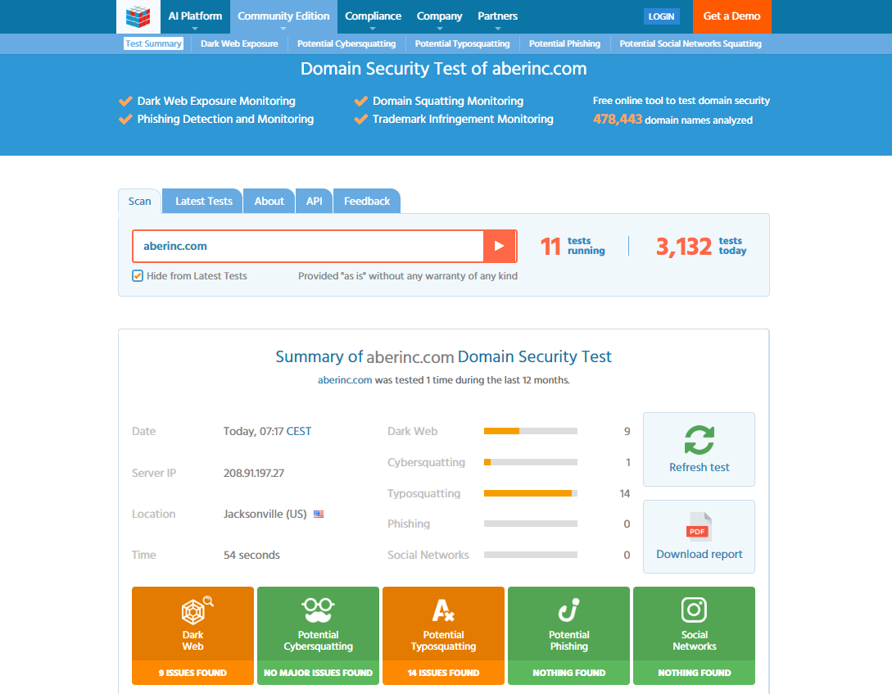
ImmuniWeb Radar
Free Dark Web Scan: https://www.immuniweb.com/radar/

Slide 30
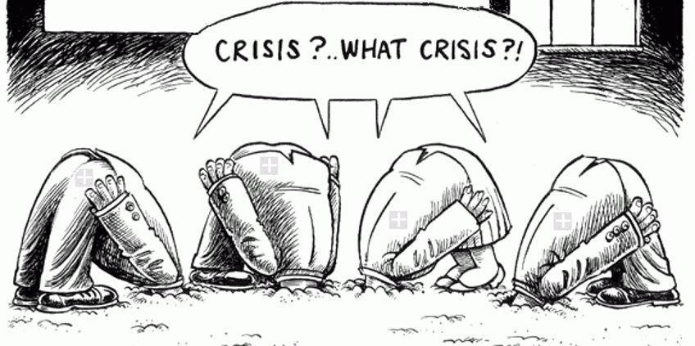
Don’t Bury Your Head in the Sand

Slide 31
Business Email Compromise

Slide 32
Business Email Compromise
BEC is a big problem for you and your customers:
  Your (the customer) email is compromised
  Another vendor of yours (the customer) is compromised
Almost always, these emails fall into 2 categories:
  Downloading and spreading additional malware automatically
  Urging the customer to perform a financial transaction immediately
Tips and Tricks to share with customers:
  BEC made up half of cyber-crime losses in 2019; $75K per scam
  Standard phishing email awareness – don’t click links or download attachments
  Pay attention to the email address
  Enable MFA for business email accounts

Slide 33
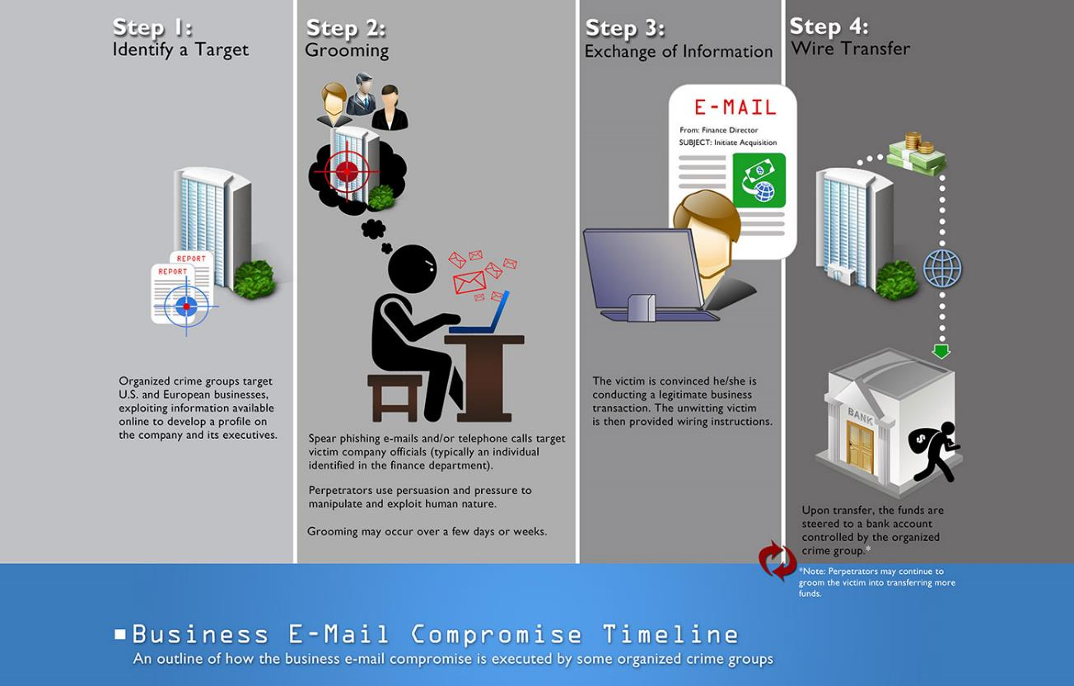
BEC Visuals

Slide 34
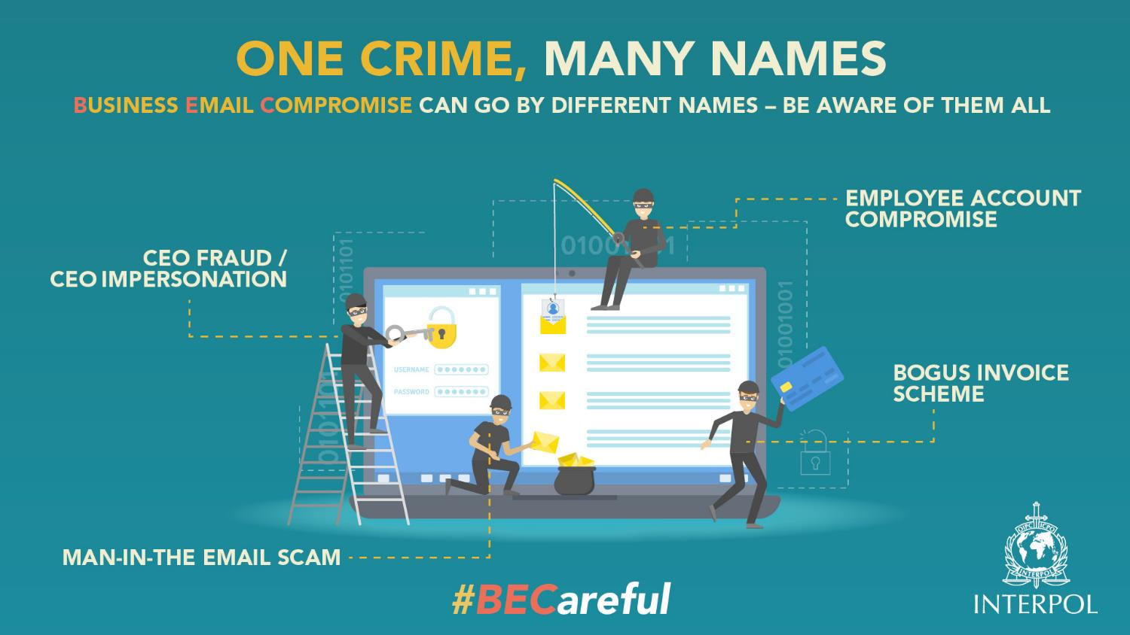
BEC Visuals

Slide 35
BEC Best Practices
Avoid using free web-based email for business
  Not only less-professional, but easier to hack, typosquat, or spoof
  Domains and email addresses are cheap, especially compared to BEC
Register similar domains to yours to prevent typosquatting
  sbscyber.com vs. sdscyber.com
Be careful about the information you share on your website or Social Media (LinkedIn, Facebook) about job duties or positions, especially for positions with transactional or purchasing authority
Think through Out of Office email responders

Slide 36
BEC Best Practices
Be suspicious of sudden changes in business practice communicated via email
  Changes in bank account numbers
  Changes in email address
  Using “personal” email rather than business email
Confirm before taking action
Look into advanced email controls, like Office 365’s ATP subscription
Use Multi-Factor Authentication!

Slide 37
Mitigating Cyber Risk

Slide 38
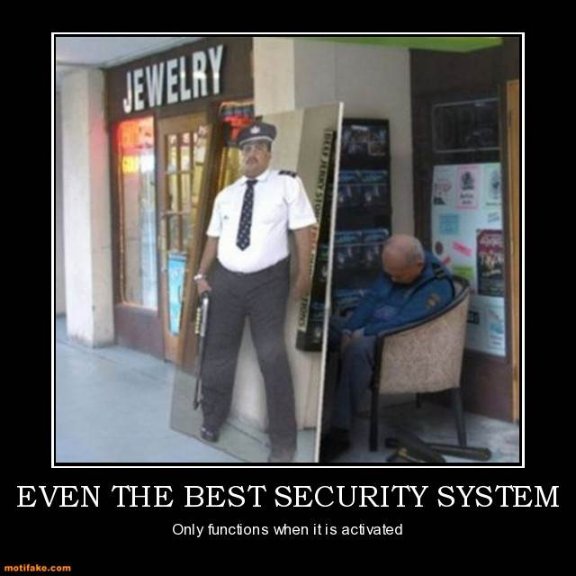
False Sense of Security?

Slide 39



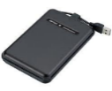
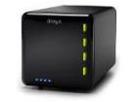
Weapons-Grade Data Backup
Backing up your data protects it from numerous threats:
  Ransomware
  Hackers destroying your computer
  Malware corrupting your data
  Fire and other natural disaster destroying your systems
  Many other threats
Include all your critical data, backup often.
Store a copy offsite. Make sure it’s AIR-GAPPED
Test your backup process to know you can restore data.
3-2-1 Backup Rule
  3 copies of your data
  2 different media
  1 copy off site (and air-gapped)

Slide 40
Religious Patch Management
Don’t just patch – patch with a PLAN
Patch Management Program
  Know your Assets – not everything has to be patched the same way or frequency
  Identify Patches
  Schedule Patches
  Test Patches
  Patch Roll-out
  Patch Roll-back
  Patch Testing
9 out of 10 breaches could have been prevented by a quality patch management program

Slide 41
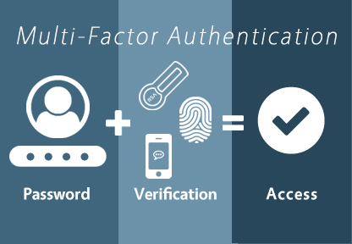
Implement MFA
Turn on MFA everywhere you can, but ESPECIALLY for anything that an employee or a customer can see from the internet:
  Email, VPN, online banking accounts, social media, etc.

Slide 42
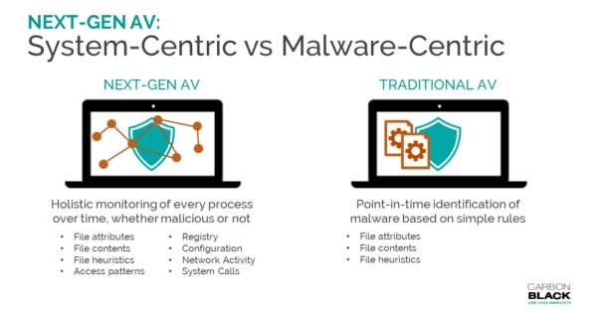
Behavior-based Anti-malware
Signature-based A/V protects against >70% of malware
Behavior-based A/V utilizes process behavior, artificial intelligence, and machine learning to identify new attacks, rather than relying on signatures

Slide 43
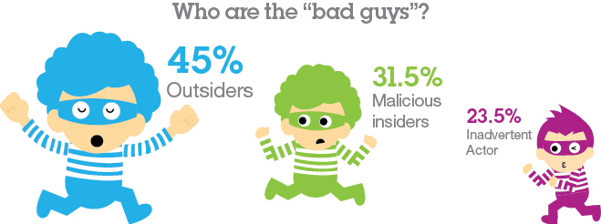
Plan to Fail Well
Understand cyber attacks:
  How cyber attacks work
  What you can do to prevent cyber attacks
  How can you DETECT attacks before they become major incidents?
Improve your capabilities to deal with a cyber attack
Test your capabilities – tabletop walkthroughs are a good start

Slide 44
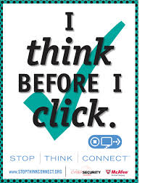
Security Awareness Training
Employees should read
security policies
Employees should sign Acceptable Use Agreement
Employees should receive training on security threats:
  Malware
  Phishing
  Social Engineering
  Unauthorized Access

Slide 45
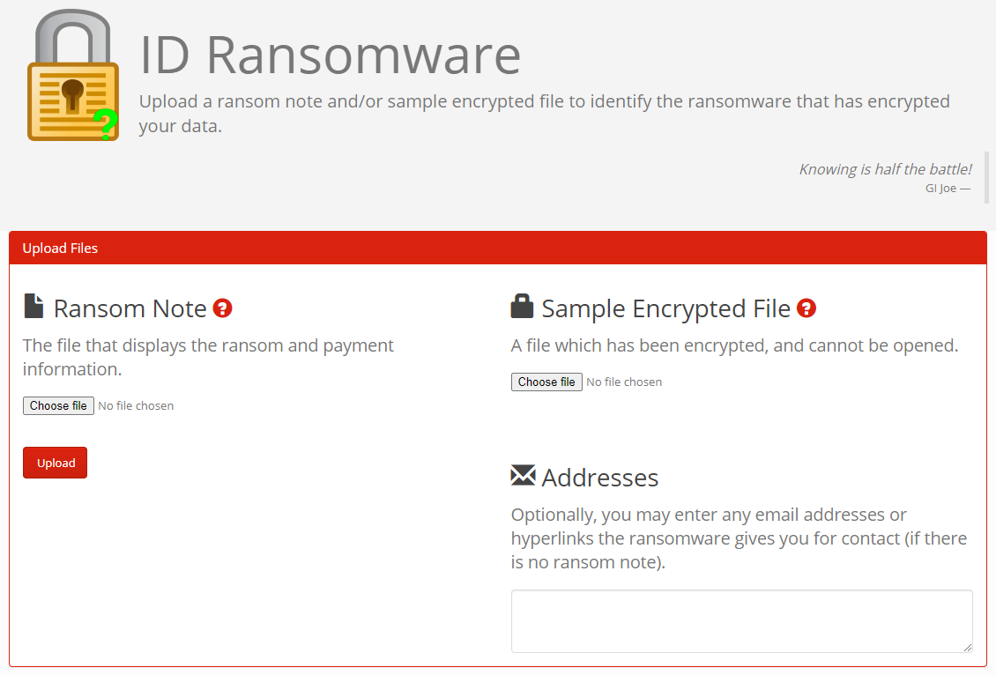
ID Ransomware
https://id-ransomware.malwarehunterteam.com/

Slide 46
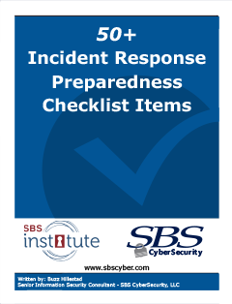
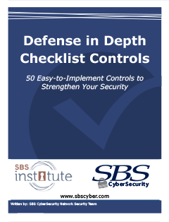
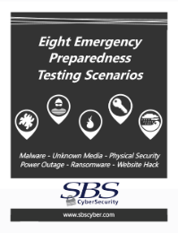
Know How to Detect
50+ Incident Response Preparedness Checklist Items:
  https://info1.sbscyber.com/incident-response/
Defense in Depth Checklist Controls:
  https://info1.sbscyber.com/defense-checklist/
Eight Emergency Preparedness Testing Scenarios:
  https://info1.sbscyber.com/emergency-preparedness-scenarios/

Slide 47
Engage Expert Resources
Build relationships or contract with IT and IS experts
  Especially if you don’t have in-house expertise
  Remember, IT is the opposite of IS – different sides to the same coin
  Do you have a relationship with a DFIR firm?
Purchase Cyber Insurance
  But know your coverages!
Use your Expert Resources to walk-through and test ransomware scenarios
Communicate – internally and externally – well. Do you have a PR or HR resource to help?

Slide 48
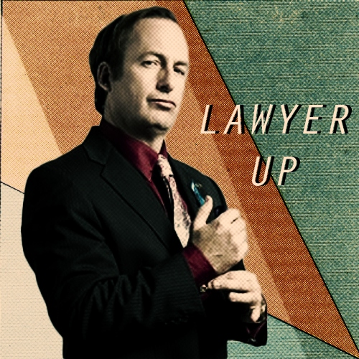
Lawyer Up
Engaging your legal team can help protect your organization, especially if an investigation is needed
  Hint: it usually is
Run communication through
legal team
Engage with law enforcement
Attorney-client privilege
Negotiate the ransom…?

Slide 49


Ransomware Questions

Slide 50

Where to Start
Perfect is the enemy of good
Just START
Good information security takes a long time
Find a partner to help
IT is NOT Information Security – they are opposite sides of the same coin

Slide 51


How We Protect Information
People
  Training, education, awareness, repetition
Process
  Governance, oversight, policy, reporting
Technology
  Firewalls, IDS/ISP, SIEM, anti-malware
  Strong passwords, Logging/monitoring
Which is the weakest link?

Slide 52
Test Yourself
Makes
Decisions
  People
  Process
  Technology
Documents
Decisions
  People
  Process
  Technology
Tests
Decisions
  People
  Process
  Technology
Risk Assessment
Information Security Program
Audit

Slide 53
Communication Security

Slide 54




Options

Slide 55

Security Issues
Security vulnerabilities – 0-Days
Malicious updates/installers
Meeting bombing
Stolen/reused credentials
Malicious links in chat
Unsecured data transmission

Slide 56
VC Security Best Practices
Use meeting passwords/unique meeting IDs
  Pay attention to meeting links or in-chat links
Patch/update software regularly
Review Security Settings
  Disable join-before-host
  Use waiting rooms/lobbies
  Turn on notifications (visual and audible)
  Don’t allow screen-sharing unless necessary; limit if needed
Use end-to-end encryption
Know where your data is being transmitted
Only use secure internet connection – don’t use public WiFi
Practice webcam awareness – what’s in your background?
Use in-browser version where possible

Slide 57

VC Governance
Make sure you’ve got strong policies/expectations around video conferencing
Acceptable Use Policy
Remote Working Policy
BYOD Policy
Train your users!
  Comply with policy
  Meet expectations
  Use the apps
  Beware of cyber threats

